Slide 1

Research Paper classification using Graph Neural Network (GNN)
Abdulqahar Mukhtar Abubakar
Department of Computer Science & Engineering,
Amrita School of Engineering, Bengaluru
Data Structures and Algorithms: 21DS603

Slide 2
Contents
Overview
Problem definition
Dataset
Machine Learning Pipeline
Implementation
Conclusion

Slide 3
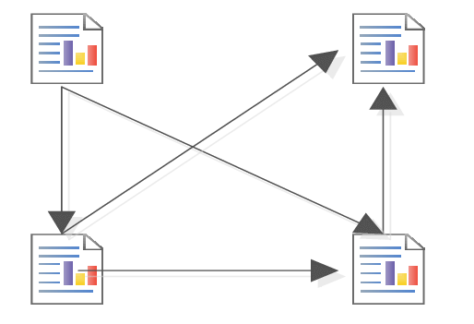
Motivation
Paper 1
Paper 3
Research Paper Citation Network consist of:
Nodes (paper)
Edges (cites)
Paper 2
Paper 4
From Geary Gallery

Slide 4
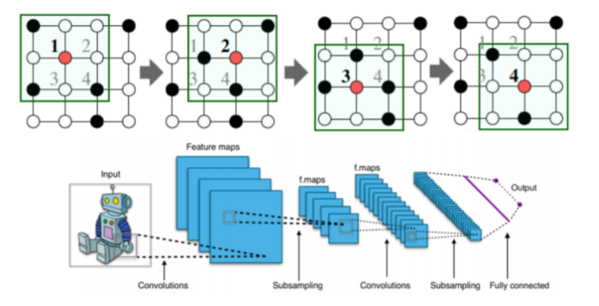
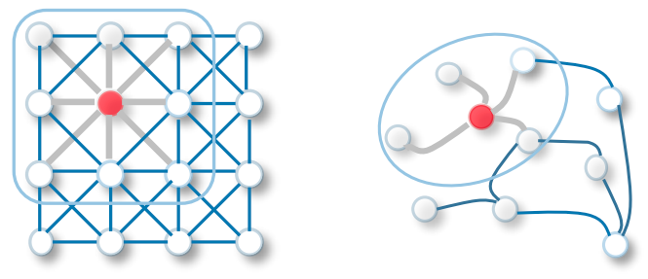
Why Graph Neural Network ?
Problems
Size and Shape
Isomorphism
Grid Structure
Neural Network
Image source: https://neptune.ai/blog/graph-neural-network-and-some-of-gnn-applications/

Slide 5
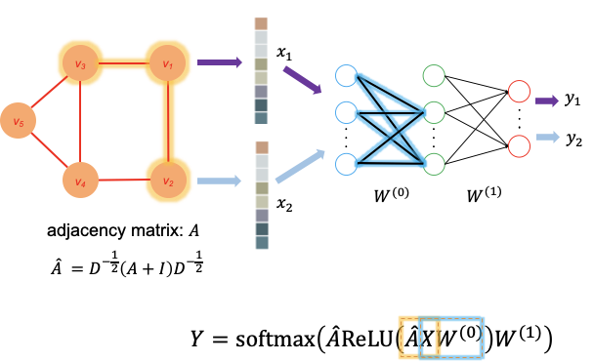
Graph Neural Network
Image source: https://towardsdatascience.com/how-to-train-graph-convolutional-network-models-in-a-graph-database-5c919a2f95d7

Slide 6
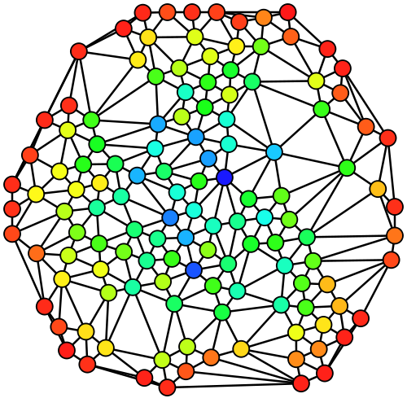
Problem Definition
Using Graphical Neural Network GNN for Node prediction task on the subject of a Research Paper given its words and citations network

Slide 7
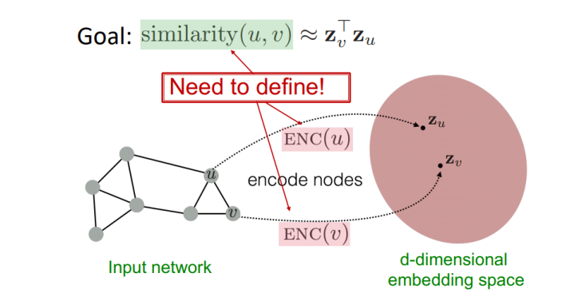
Node Embedding
Image source: https://neptune.ai/blog/graph-neural-network-and-some-of-gnn-applications/

Slide 8
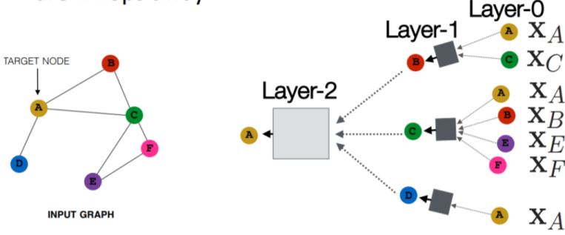
Encoder function
Encoder function should be able to perform
Locality
Aggregation
Composition
Image source: https://neptune.ai/blog/graph-neural-network-and-some-of-gnn-applications/

Slide 9
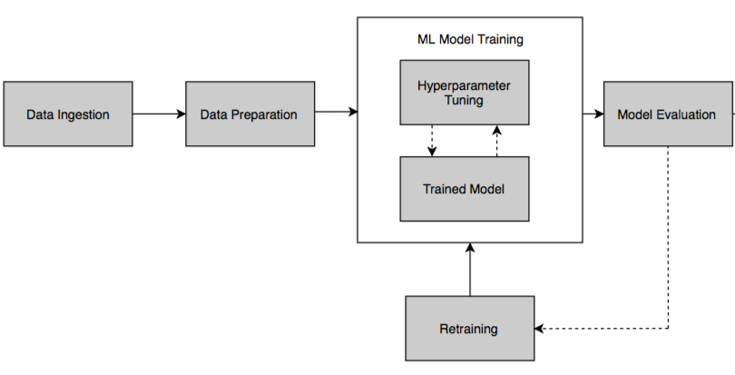
Model Pipeline
Image source: https://hub.packtpub.com/automl-build-machine-learning-pipeline-tutorial/

Slide 10
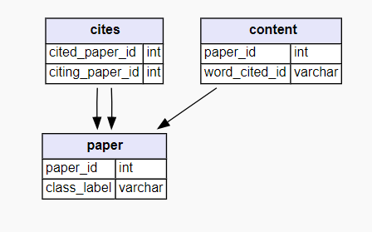
Dataset
Task: Node Classification
Nodes: 2708 scientific publications
Edges: The citation network consists of 5429 links
Dictionary: 1433 unique words
Word Vector: 0/1
source: https://relational.fit.cvut.cz/dataset/CORA

Slide 11
Implementation
https://colab.research.google.com/drive/1mzqWFXgur_0h7DFmSLEehk5r1UXCy5O8#scrollTo=Jnc9MLhkBy0Z

Slide 12
Conclusion
Research paper classification implemented using Graph Neural Network achieving an accuracy of 81.27%.

Slide 13


